Slide 1
Developing a Blockchain-Based eVault for Legal Records
PIP4004 University Project
Final Review
Batch Number: CSE_CST_17
Under the Supervision of,
Prof. Shaik Salma Begum
School of Computer Science and Engineering
Presidency University
Roll Number | Student Name
20211CST0006 | Nagaruru Sunandhan
20211CST0039 | Bobbiti Yaswanth Reddy
20211CST0041 | Kruthika S
Name of the Program: BTech
Name of the HoD: Dr. Saira Banu
Name of the Program Project Coordinator: Dr. H M Manjula
Name of the School Project Coordinators: Dr. Abdul Khadar A

Slide 2
Introduction
Traditional legal record systems face issues like data tampering, unauthorized access, and slow retrieval processes.
These challenges affect judicial efficiency and reduce trust in legal institutions.
This project proposes a blockchain-based e-Vault to provide secure, tamper-proof, and transparent document management.
It uses smart contracts for automated access control and audit logging, ensuring only authorized access.
A hybrid design with blockchain and off-chain storage ensures both data integrity and system scalability.

Slide 3
Literature Review
NyaYa: Blockchain-based Electronic Law Record Management Scheme for Judicial Investigations Pronaya Bhattacharya, Deepti Saraswat, Sudeep Tanwar (2021).
Blockchain Technology for Secure and Transparent Legal Record Management Satoshi Nakamoto (2008).
Smart Contracts for Access Control and Permissions in Blockchain Systems Vitalik Buterin (2014).
User-Friendly Interfaces for Blockchain Applications Mougayar W (2016).
Interoperability of Blockchain Systems with Existing Databases Cachin C & Vukolic M (2017).
Recordism: A Social-Scientific Prospect of Blockchain from Social, Legal, Financial, and Technological Perspectives Zihao Li, Hao Xu, Yang Fang, Boyuan Zhao, Lei Zhang (2022).

Slide 4
Research Gaps Identified
Lack of Robust Immutability.
Inadequate Access Control Mechanisms.
Limited Interoperability with Existing Legal Infrastructure.
Scalability Constraints in Blockchain Implementations.
Regulatory Compliance and User Adoption Challenges.

Slide 5
Proposed Methodology
The system uses a permissioned blockchain to record document metadata and cryptographic hashes, ensuring tamper-proof tracking.
Smart contracts are implemented to automate access control, allowing only authorized users to perform actions based on their roles.
Actual legal documents are encrypted and stored off-chain in a distributed file system like IPFS to maintain scalability and privacy.
Users interact with the system through a web-based interface that supports uploading, retrieving, and sharing of documents securely.
Integration with existing legal systems is enabled through APIs, allowing seamless communication with court databases and case management tools.

Slide 6
Objectives
Secure and tamper-proof document storage.
Transparent audit trails.
Granular access control using smart contracts.
Interoperability with legacy systems.
High scalability and regulatory compliance.
Promote user adoption through intuitive interfaces.

Slide 7
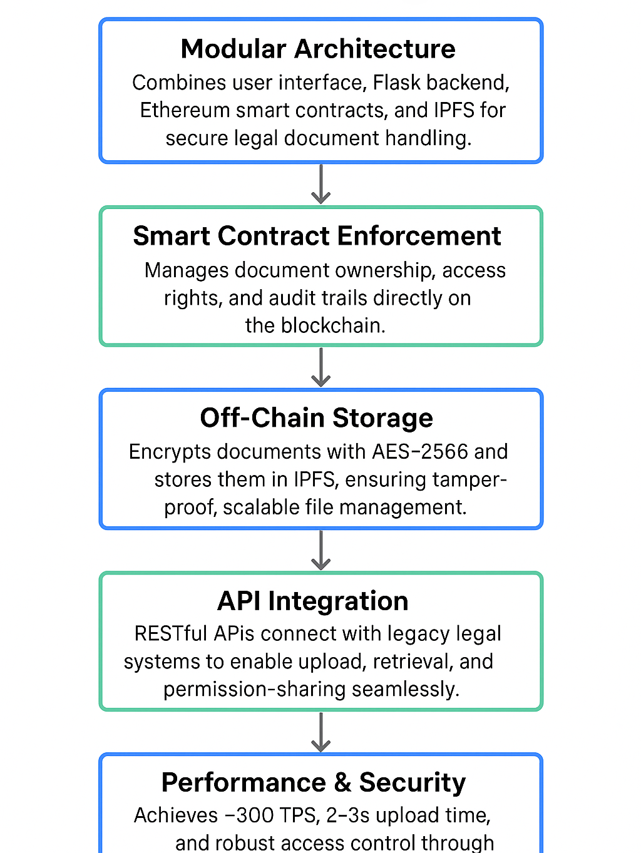
System Design & Implementation

Slide 8
System Design & Implementation
Modular Architecture: Combines user interface, Flask backend, Ethereum smart contracts, and IPFS for secure legal document handling.
Smart Contract Enforcement: Manages document ownership, access rights, and audit trails directly on the blockchain.
Off-Chain Storage: Encrypts documents with AES-256 and stores them in IPFS, ensuring tamper-proof, scalable file management.
API Integration: RESTful APIs connect with legacy legal systems to enable upload, retrieval, and permission-sharing seamlessly.
Performance & Security: Achieves ~300 TPS, 2–3s upload time, and robust access control through blockchain-verified permissions.

Slide 9
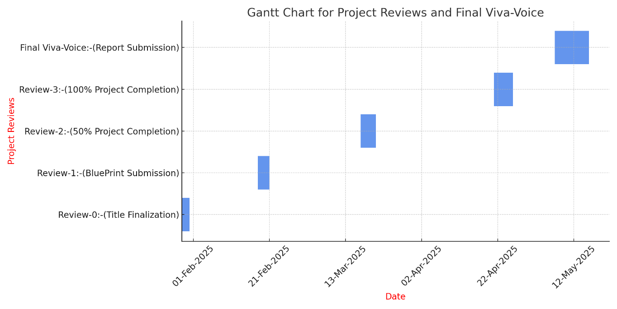
Timeline of Project

Slide 10
Outcomes
Secure storage and retrieval of legal documents using blockchain.
Tamper-proof document verification through cryptographic hashing.
Role-based and attribute-based access control via smart contracts.
Transparent and immutable audit trails for all document actions.
Scalable architecture using off-chain IPFS storage.
Easy-to-use web and mobile interfaces for stakeholders.
Enhanced trust and transparency in judicial processes.
Reduced administrative burden and faster legal workflows.

Slide 11
Conclusion
The blockchain-based e-Vault system enhances the security, transparency, and efficiency of legal document management. By leveraging smart contracts and decentralized storage, it offers tamper-proof audit trails and controlled access. The prototype demonstrates promising results, indicating its potential to transform traditional legal workflows and foster trust in judicial processes, paving the way for future digital legal innovations.

Slide 12
References
J. N. Barlow, “Security considerations in electronic vault systems for data storage,” J. Inf. Secur., vol. 2, no. 4, pp. 175–183, Nov. 2012.
A. Wright and P. De Filippi, “Lex cryptographia: Blockchain technology and the future of legal frameworks,” SSRN Electron. J., Feb. 2015, doi: 10.2139/ssrn.2580664.
C. Cachin, “Hyperledger Fabric: Architecture and design principles,” in Proc. Workshop Distrib. Cryptocurrencies Consensus Ledgers, Chicago, IL, USA, Jul. 2016, pp. 1–8.
M. Benchoufi, R. Porcher, and P. Ravaud, “Blockchain for transparent consent management in clinical trials,” F1000Research, vol. 6, p. 66, Jan. 2017, doi: 10.12688/f1000research.10571.1.
M. Pilkington, “Blockchain applications and principles in digital transformation,” in Research Handbook on Digital Transformations, F. X. Olleros and M. Zhegu, Eds. Cheltenham, UK: Edward Elgar Publishing, 2016, pp. 225–253.

Slide 13
References
N. Szabo, “Smart contracts: Formalizing and securing digital agreements,” First Monday, vol.2, no. 9, Sep. 1997, doi: 10.5210/fm.v2i9.548.
V. Buterin, “Ethereum: A next-generation smart contract platform,” Ethereum White Paper, Nov. 2014. [Online]. Available: https://ethereum.org/en/whitepaper/.
J. Benet, “IPFS: Content-addressed, peer-to-peer file system,” arXiv preprint arXiv:1407.3561, Jul. 2014.
M. Castro and B. Liskov, “Practical Byzantine Fault Tolerance for distributed systems,” in Proc. 3rd Symp. Oper. Syst. Design Implementation, New Orleans, LA, USA, Feb. 1999, pp. 173–186.
D. Ongaro and J. Ousterhout, “Raft: A consensus algorithm for understandable replication,” in Proc. USENIX Annu. Tech. Conf., Philadelphia, PA, USA, Jun. 2014, pp. 305–320.

Slide 14
Publication Details
Journal Name : Springer, SCOPUS Indexed
Status : Accepted
Chapter Title: Block Juris Vault - Emphasizes blockchain-based legal storage

Slide 15


